Slide 1
Randomized Algorithms CS648A
Lecture 22
Hashing – I
Probabilistic Methods - I

Slide 2
Part I
Hashing with worst case guarantee

Slide 3

Problem Definition
$U=\left\{1,2,…,m\right\}$ called universe
$S⊆U$ and $s=|S|$
$s≪$ $m$
Examples:
$m={10}^{18}$ , $s={10}^{3}$
Aim
Build a data structure for a given $S$to support the search query :
“Does $i∈$ $S$ ?” for any $i∈U$.

Slide 4
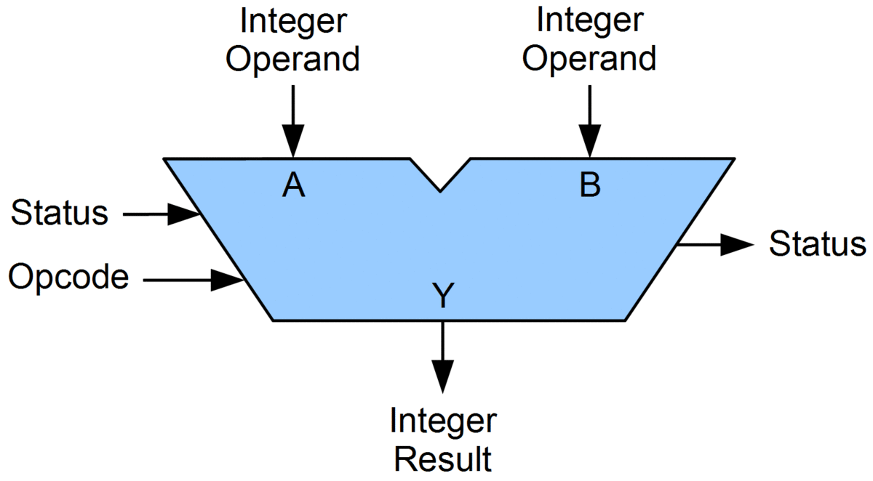

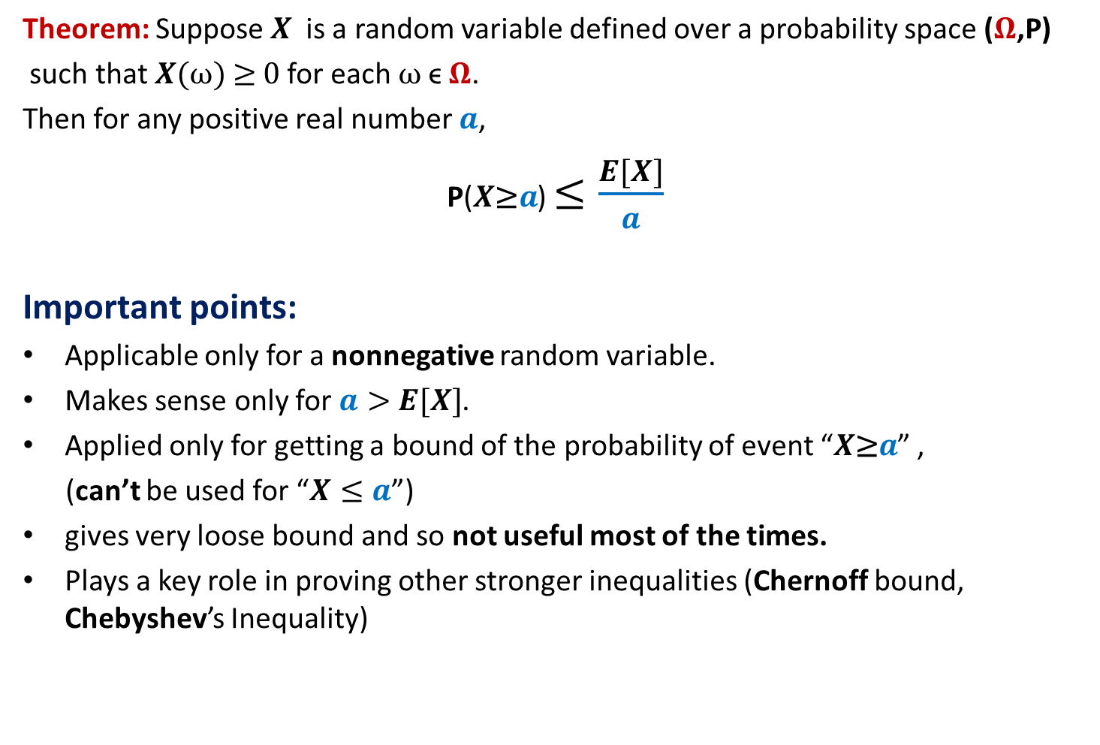
Solutions
with worst case guarantees
Practical solution with no worst case guarantees
 | Query time | Data structure | Space
Static $S$ | O($log s$) | Array | O($s$)
Dynamic $S$ | O($log s$) | Red-Black trees | O($s$)
Dynamic $S$ | O($1$) | Array
Makes use of comparison
as the basic operation
O($m$)
Impractical
Makes use of fast arithmietic operations on integers
Hashing
ALU
Few cycles for an arithmetic operation

Slide 5


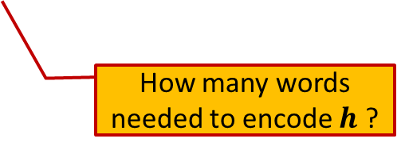
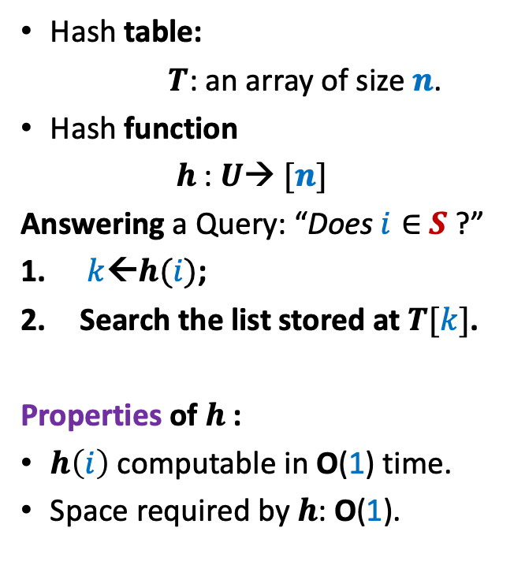

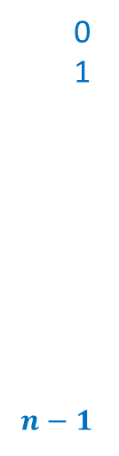

Hashing
Hash table:
$T$: an array of size $n$.
Hash function
$h$: $U$→ $[n]$
Answering a Query: “Does $i∈$ $S$ ?”
$k$←$h(i)$;
Search the list stored at $T[k]$.
Properties of $h$:
$h\left(i\right)$ computable in O(1) time.
Space required by $h$: O(1).
Elements of $S$
$$T$$
0
1
$$n−1$$
$$⋮$$
$$⋮$$
How many words needed to encode $h$ ?

Slide 6
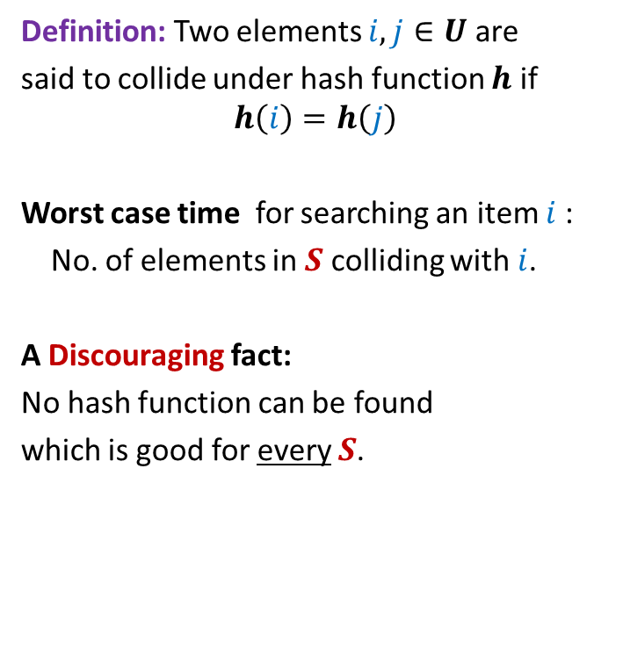
Collision
Definition: Two elements $i,j∈U$ are
said to collide under hash function $h$ if
$$h\left(i\right)=h\left(j\right)$$
Worst case time for searching an item $i$:
No. of elements in $S$ colliding with $i$.
A Discouraging fact:
No hash function can be found
which is good for every $S$.
$$T$$
0
1
$$n−1$$
$$⋮$$
$$⋮$$

Slide 7

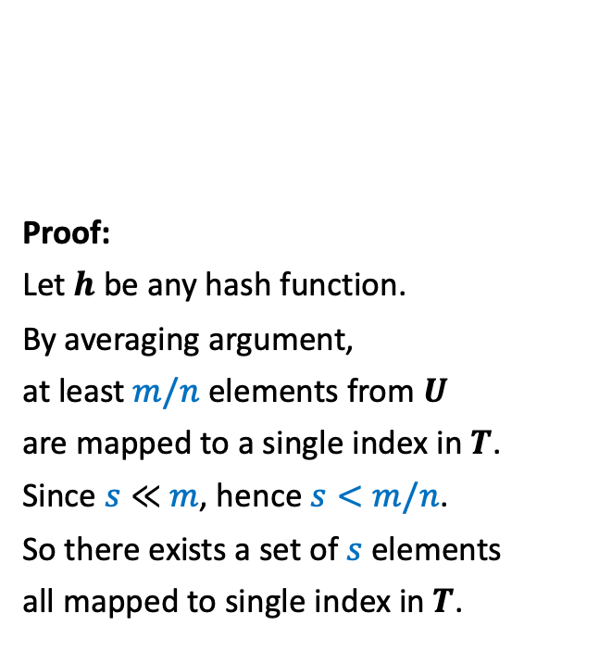
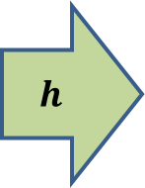


Collision
1
2
Proof:
Let $h$ be any hash function.
By averaging argument,
at least $m/n$ elements from $U$
are mapped to a single index in $T$.
Since $s≪$ $m$, hence $s<m/n$.
So there exists a set of $s$ elements
all mapped to single index in $T$.
$$T$$
0
1
$$n−1$$
$$h$$
$$⋮$$
$$⋯$$
$$⋮$$
$$s$$
$$m$$

Slide 8
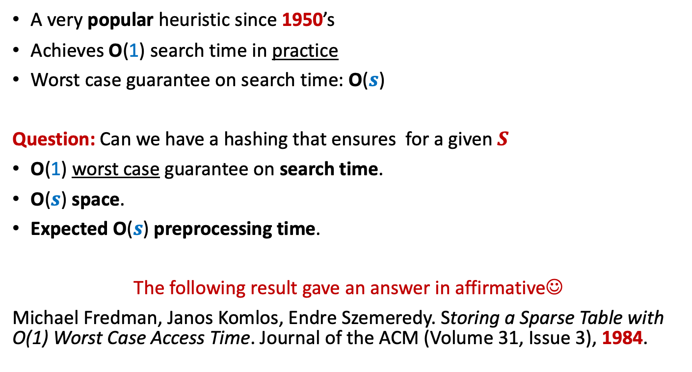
History of Hashing
A very popular heuristic since 1950’s
Achieves O(1) search time in practice
Worst case guarantee on search time: O($s$)
Question: Can we have a hashing that ensures for a given $S$
O(1) worst case guarantee on search time.
O($s$) space.
Expected O($s$) preprocessing time.
The following result gave an answer in affirmative☺
Michael Fredman, Janos Komlos, Endre Szemeredy. Storing a Sparse Table with O(1) Worst Case Access Time. Journal of the ACM (Volume 31, Issue 3), 1984.

Slide 9
Why does hashing work so well in Practice ?

Slide 10
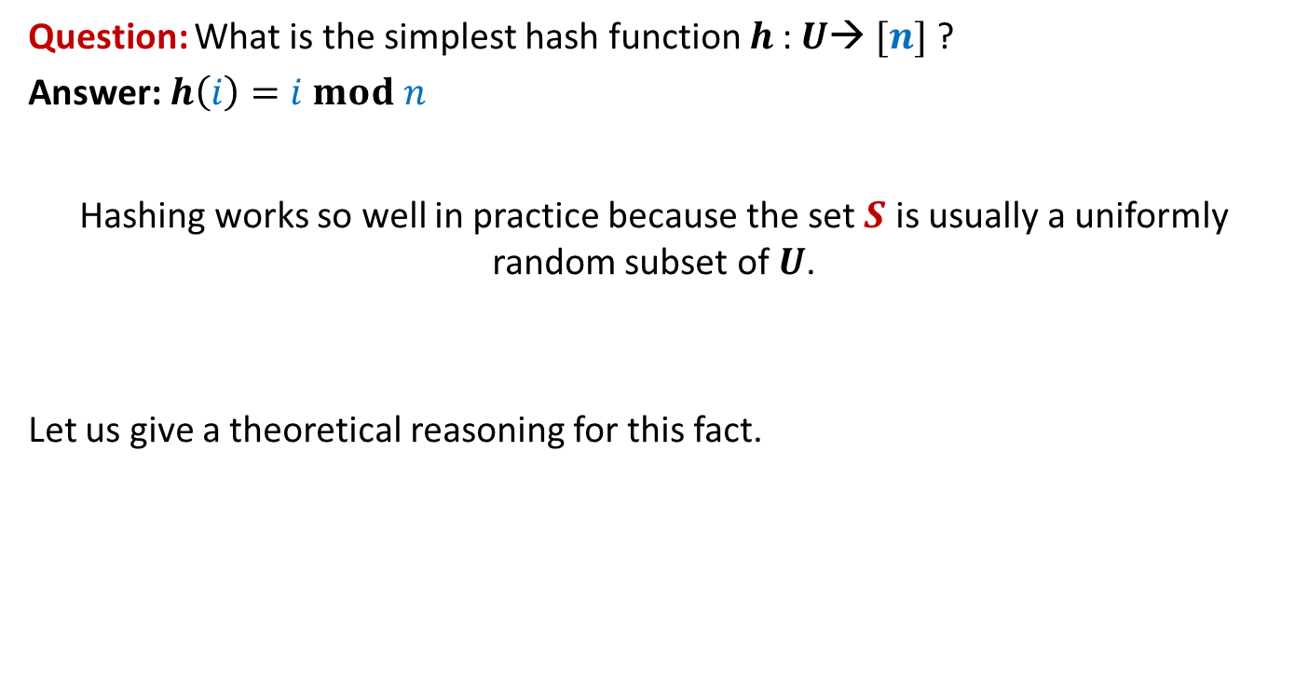
Why does hashing work so well in Practice ?
Question: What is the simplest hash function $h$: $U$→ $[n]$ ?
Answer: $h\left(i\right)=i mod n$
Hashing works so well in practice because the set $S$ is usually a uniformly random subset of $U$.
Let us give a theoretical reasoning for this fact.

Slide 11











Why does hashing work so well in Practice ?
Let $y_{1},y_{2},…,y_{s}$ denote $s$elements
selected randomly uniformly from $U$ to form $S$.
Question:
What is expected number of elements
colliding with $y_{1}$?
Answer: Let $y_{1}$ takes value $i$.
P($y_{j}$ collides with $y_{1}$) = ??
1
2
$$⋮$$
$$i−n$$
$$i$$
How many possible values can $y_{j}$ take ?
$$i+n$$
$$m−1$$
$$i+2n$$
How many possible values can collide with $i$ ?
$$i+3n$$
$$⋮$$
m

Slide 12
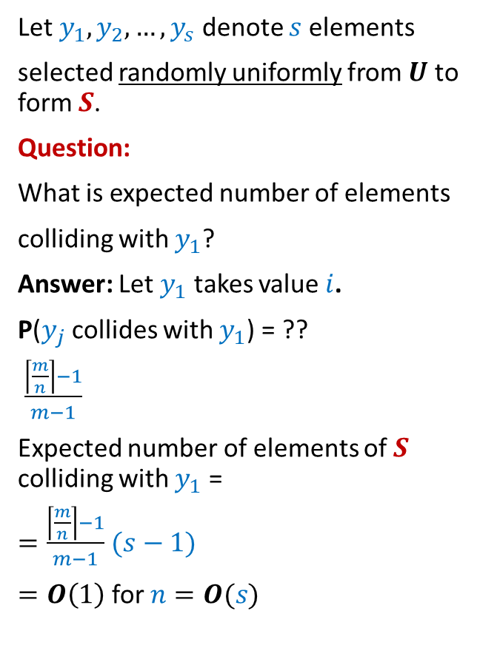


Why does hashing work so well in Practice ?
Let $y_{1},y_{2},…,y_{s}$ denote $s$elements
selected randomly uniformly from $U$ to form $S$.
Question:
What is expected number of elements
colliding with $y_{1}$?
Answer: Let $y_{1}$ takes value $i$.
P($y_{j}$ collides with $y_{1}$) = ??
$\frac{\left\lceil \frac{m}{n}\right\rceil −1}{m−1}$
Expected number of elements of $S$ colliding with $y_{1}$ =
$=\frac{\left\lceil \frac{m}{n}\right\rceil −1}{m−1}$ $(s−1)$
$=O\left(1\right)$ for $n=O(s)$
1
2
$$⋮$$
$$i−n$$
Values which may collide with $i$ under the hash function $h\left(x\right)=x mod n$
$$i$$
$$i+n$$
$$i+2n$$
$$i+3n$$
$<\left\lceil \frac{m}{n}\right\rceil \frac{s}{m}$
$$⋮$$
m

Slide 13
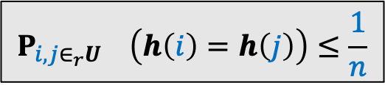

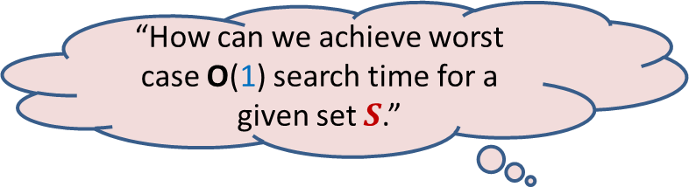
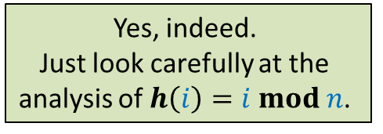
Why does hashing work so well in Practice ?
Conclusion
$h\left(i\right)=i mod n$ works so well because
for a uniformly random subset of $U$,
the expected number of collision at an index of $T$ is O(1).
Homework:
Show that for every hash function $h$ will also do well in practice provided it satisfies the following inequality.
Can there be other hash functions as well that will do well in practice ?
Yes, indeed.
Just look carefully at the
analysis of $h\left(i\right)=i mod n$.
$$P_{i,j∈_{r}U} \left(h\left(i\right)=h\left(j\right)\right)≤\frac{1}{n}$$
“How can we achieve worst case O(1) search time for a given set $S$.”
But it is easy to fool each such hash function
such that it achieves O(s) search time.

Slide 14
How to achieve worst case O(1) search time

Slide 15





Key idea to achieve worst case O(1) search time
A promising direction:
Find out a family of hash functions H such that
For any given $S$ , many of them are good.
Select a function randomly from H and try for $S$.
No hash function which is good for every $S$
A good hash function for a given $S$
Of course, no single hash function is good for every possible $S$.
But we may strive for a hash function which is good for a given $S$.
The notion of goodness is captured formally by Universal hash family in the next lecture. Ponder over it …

Slide 16
Part II
Probabilistic Methods

Slide 17
Probabilistic methods
Methods that use
Probability theory or
Randomized algorithm
to prove deterministic combinatorial results

Slide 18
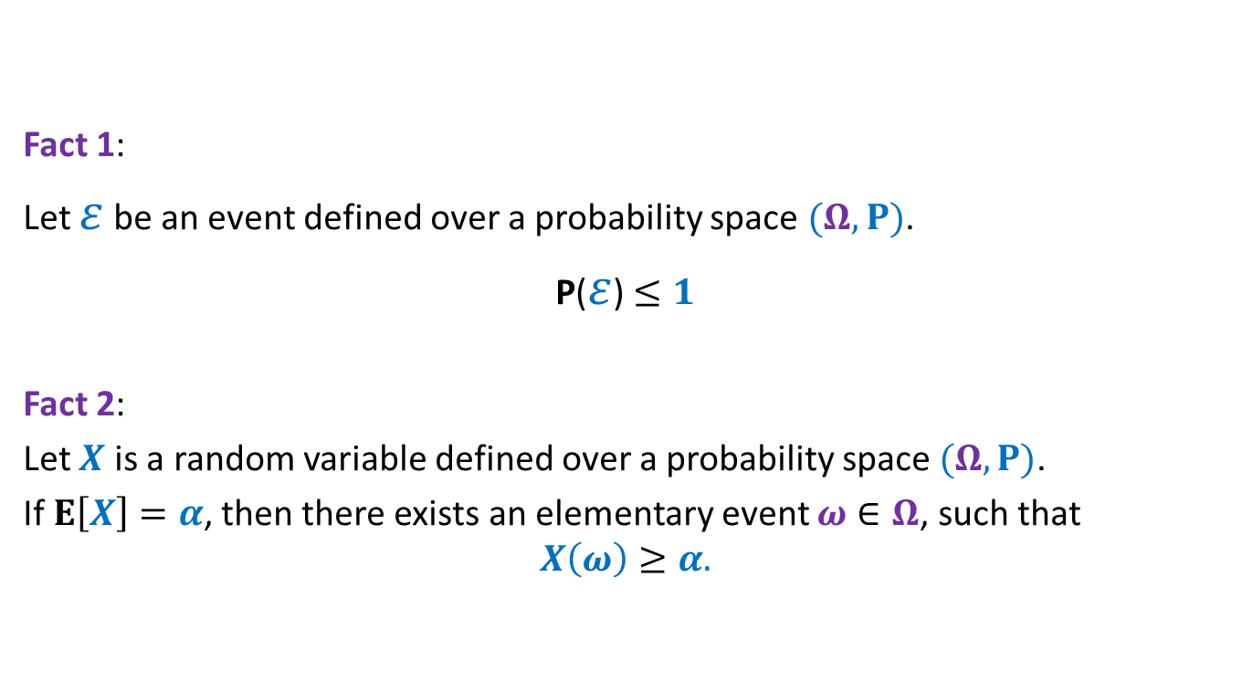
Elementary facts from probability theory
Fact 1:
Let $ε$ be an event defined over a probability space $(Ω,P)$.
P($ε$)$≤1$
Fact 2:
Let $X$ is a random variable defined over a probability space $(Ω,P)$.
If $E\left[X\right]=α$, then there exists an elementary event $ω∈Ω$, such that
$$X\left(ω\right)≥α.$$

Slide 19
problem 1 How Many min CUTs ?

Slide 20


Min-Cut
$G=(V,E)$: undirected connected graph
Definition (cut):
A subset $C⊆E$whose removal disconnects the graph.
Definition (min-cut): A cut of smallest size.
Question: How many cuts can there be in a graph?
Question: How many min-cuts can there be in a graph?
$$\frac{2^{n}−2}{2}$$

Slide 21

Algorithm for min-cut
Min-cut($G$):
{ Repeat $n−2$ times
{
Let $e∈_{r}G$;
$G$ ← Contract($G,e$).
}
return the edges of multi-graph $G$;
}
Running time: $O(n^{2})$
Question:
What is the sample space of the output of the algorithm ?
Answer: all-cuts of $G$.

Slide 22
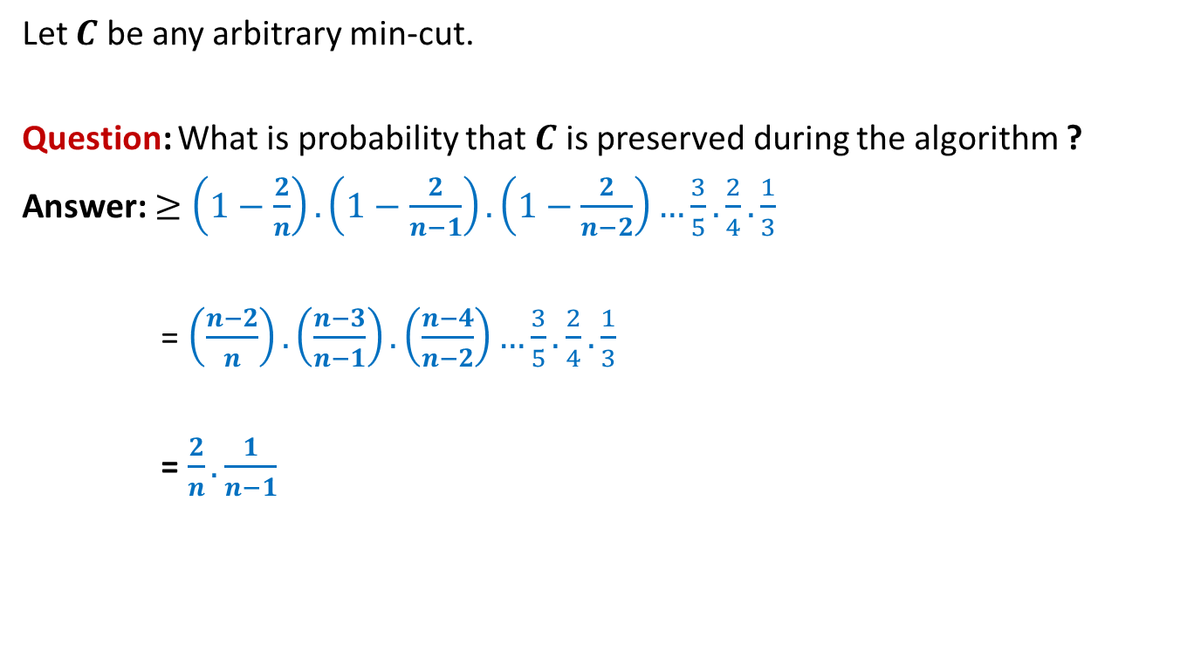
Analysis of Algorithm for min-cut
Let $C$ be any arbitrary min-cut.
Question: What is probability that $C$ is preserved during the algorithm ?
Answer: $≥\left(1−\frac{2}{n}\right).\left(1−\frac{2}{n−1}\right).\left(1−\frac{2}{n−2}\right)…\frac{3}{5}.\frac{2}{4}.\frac{1}{3}$
= $\left(\frac{n−2}{n}\right).\left(\frac{n−3}{n−1}\right).\left(\frac{n−4}{n−2}\right)…\frac{3}{5}.\frac{2}{4}.\frac{1}{3}$
= $\frac{2}{n}.\frac{1}{n−1}$

Slide 23

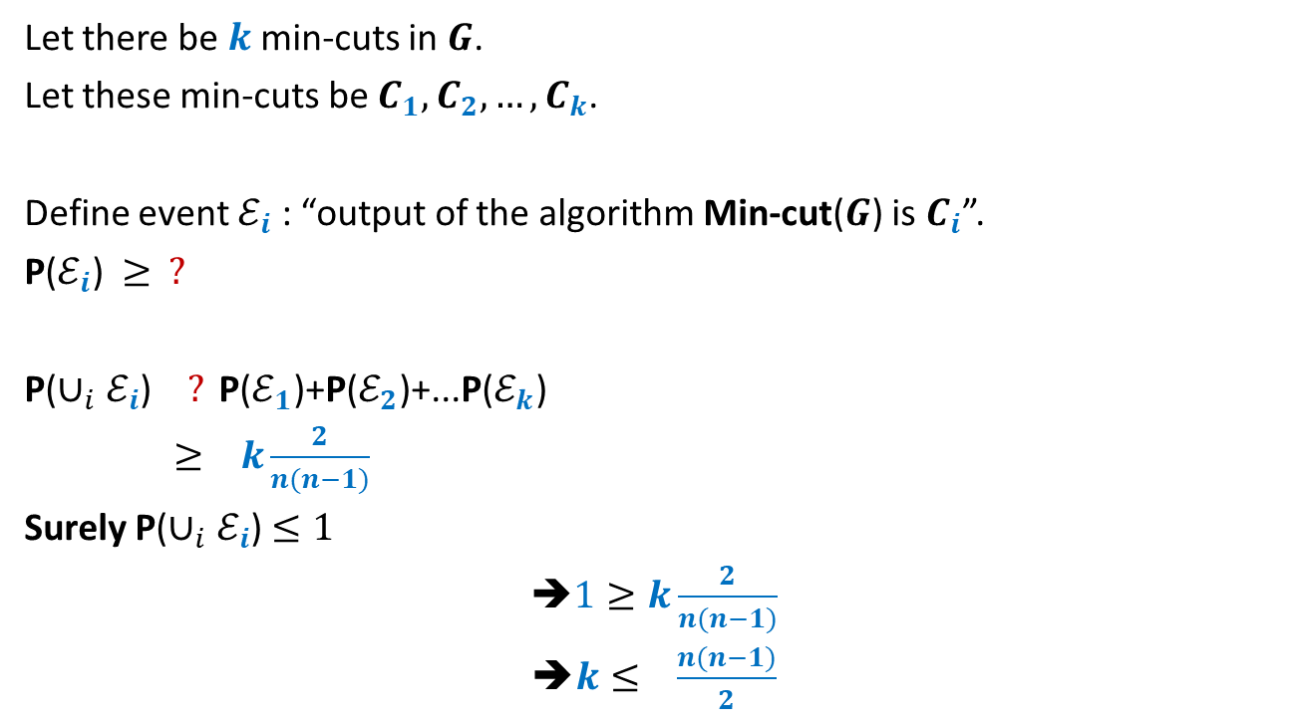

Number of min-cuts
Let there be $k$ min-cuts in $G$.
Let these min-cuts be $C_{1},C_{2},…,C_{k}$.
Define event $ℰ_{i}$ : “output of the algorithm Min-cut($G$) is $C_{i}$”.
P($ℰ_{i}$)$≥ ?$
P($∪_{i}ℰ_{i}$) $? \text{P}\text{(}ℰ_{1}\text{)}\text{+}\text{P}\text{(}ℰ_{2}\text{)}\text{+...}\text{P}\text{(}ℰ_{k}\text{)}$
$≥ k\frac{2}{n(n−1)}$
Surely P($∪_{i}ℰ_{i}$) $≤1$
➔$1≥k\frac{2}{n(n−1)}$
➔$k≤ \frac{n(n−1)}{2}$
$$\frac{2}{n(n−1)}$$
$$=$$
At the end of the algorithm
Disjoint events
…
we are left with a multigraph with 2 vertices. Each of these vertices corresponds to a unique subset of vertices. So the corresponding cut is uniquely defined.

Slide 24
problem 2 How many Acute Triangles ?

Slide 25
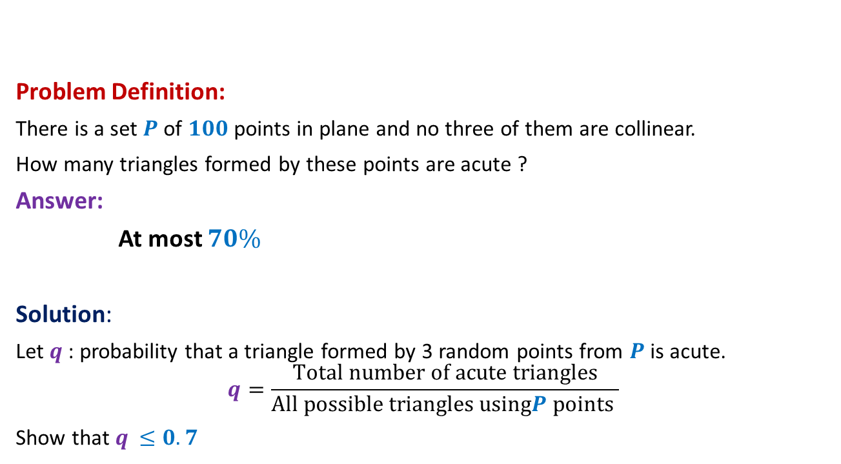
How many acute triangles
Problem Definition:
There is a set $P$of $100$points in plane and no three of them are collinear.
How many triangles formed by these points are acute ?
Answer:
At most $70\%$
Solution:
Let $q$ : probability that a triangle formed by 3 random points from $P$is acute.
$$q=\frac{Total number of acute triangles}{All possible triangles usingP points }$$
Show that $q$ $≤0.7$

Slide 26


$4$ points
Case 1:
Sum of the four angles is $360$.
➔at least one of them has to be $≥90$
Hence, at least one of the four triangles is non-acute.

Slide 27

$4$ points
Case 2:
Sum of the three angles at the center is $360$.
➔at least two of these angles have to be $>90$
➔at least 2 of the four triangles is non-acute.

Slide 28


$4$ points ➔ $5$ points
Lemma1: A triangle formed by selecting 3 points randomly uniformly
from 4 points is acute triangle with probability at most $0.75$.
Lemma2: A triangle formed by selecting 3 points randomly uniformly
from 5 points is acute triangle with probability at most $0.7$.
Extension to 100 points ?
☹

